Slide 1

Predictive Model for Heart failure Detection
B.TECH 2022-26 5TH SEM Minor Project-I

Slide 2

PROJECT PRESENTED BY

Slide 3
Table of contents
01
02
04
05
06
07
03
Introduction
Hardware and
Software
requirement
Data
Preprocessing
Model Selection
Dataset
08
09
10
Flow chart
Evaluation Metrics
Screenshot
Future Work
Conclusion

Slide 4

The greatest wealth is health…

Slide 5

Introduction
Heart failure is a serious medical condition where the heart is unable to pump blood effectively, leading to a range of health complications. Early prediction of heart failure is crucial, as it can significantly improve patient outcomes by enabling timely intervention and treatment.
The goal of this project is to develop a machine learning model capable of predicting the likelihood of heart failure based on patient data. By aiding in early diagnosis, this model can help healthcare providers identify high-risk patients before symptoms become severe, facilitating prompt and effective care.

Slide 6
Hardware & Software Requirements
Hardware Requirments:
Laptop equipped with at least 16GB of RAM and 500 GB of storage.
Operating System: Windows 11
Software Requirments:
Development Environment- Python IDE (e.g. VS Code & Google Colab)
Language:- Python
Libraries:- Pandas,NumPy,Scikit-learn,Matplotlib,Seaborn

Slide 7

Dataset
Source:- The dataset used for this project was sourced from Kaggle which provides comprehensive information on patient health.
Features
Resting ECG
Max HR
Exercise Angina
Old peak
ST Slope
Heart Failure
Age
Sex
Chest Pain Type
Resting BP
Cholesterol
Fasting BS

Slide 8
Data Preprocessing
Handling Missing Values: -
Missing data was handled using imputation techniques to ensure completeness
Feature Scaling: -
Numerical features were scaled using Standard Scaler to standardize the data and improve model performance
Encoding Categorical Variables: -
Categorical features were encoded to convert them into numerical values

Slide 9

Model Selection
Models Used:
Logistic Regression: A linear model for binary classification
Decision Trees: A model that splits data into branches to make predictions
Random Forest: An ensemble of decision trees to improve prediction accuracy
KNN Classifier: A non linear model for binary classification
Model Performance:
Accuracy: 91.5%

Slide 10
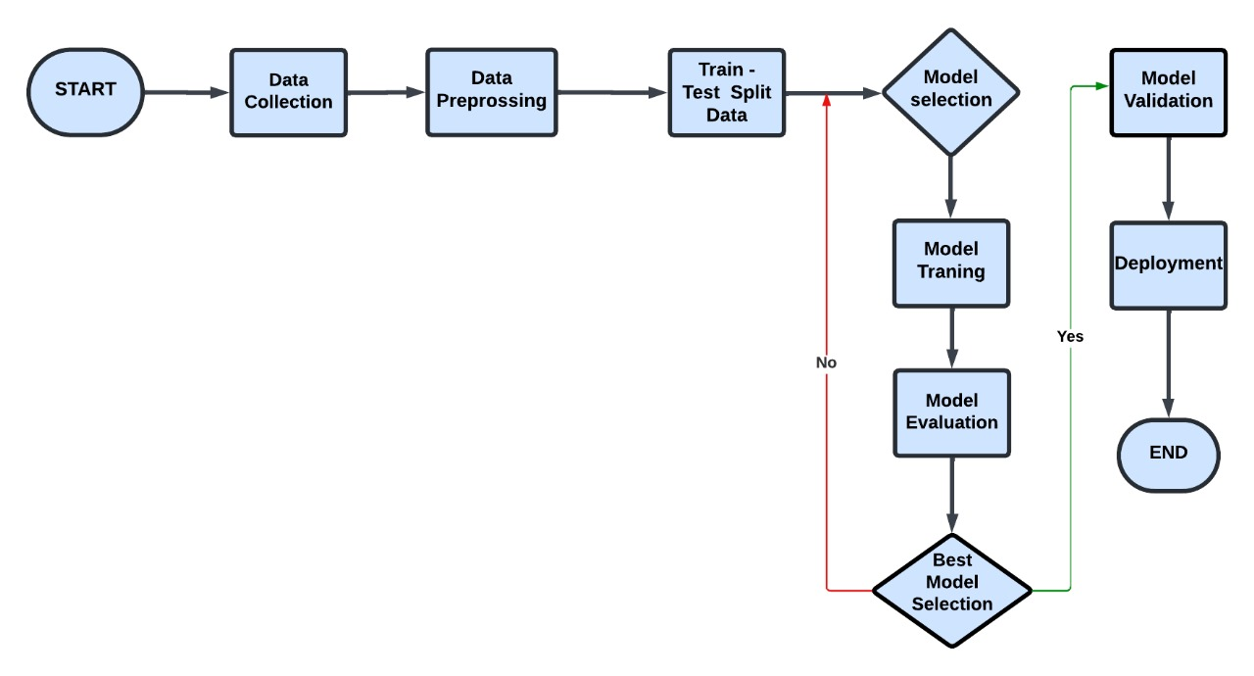
Flow chart

Slide 11

Evaluation Metrics
Metrics Used:
Accuracy: The proportion of correctly predicted instances
Precision: The proportion of true positive results out of all positive predictions
Recall: The proportion of true positive results out of all actual positives
F1 Score: The harmonic mean of precision and recall
Confusion Matrix: It shows the true positives,false positives,true negatives and false negatives.
Results:
Best Accuracy: 92%
Mean Accuracy: 86.17%

Slide 12
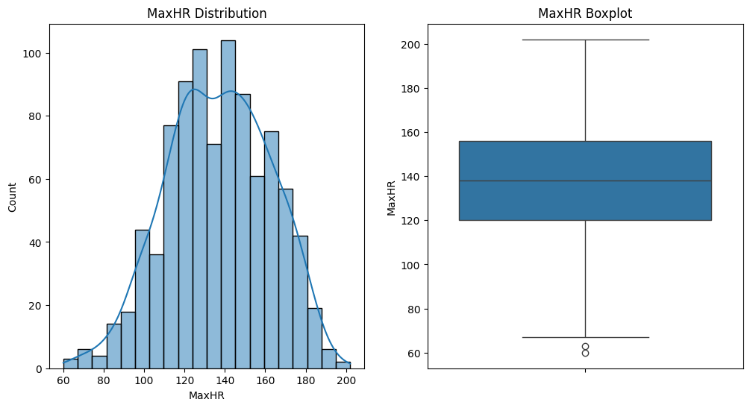
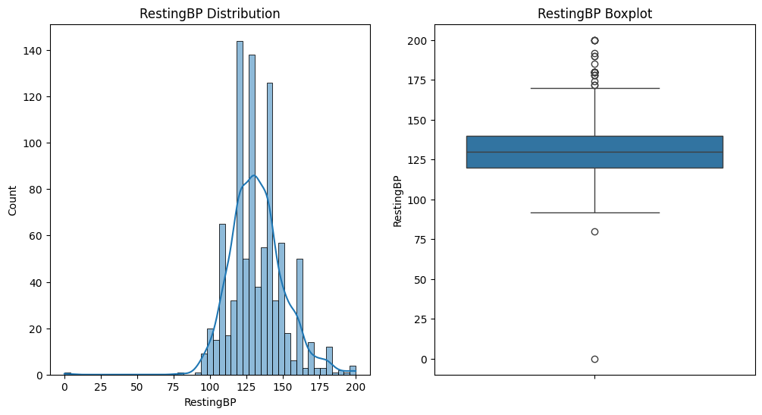
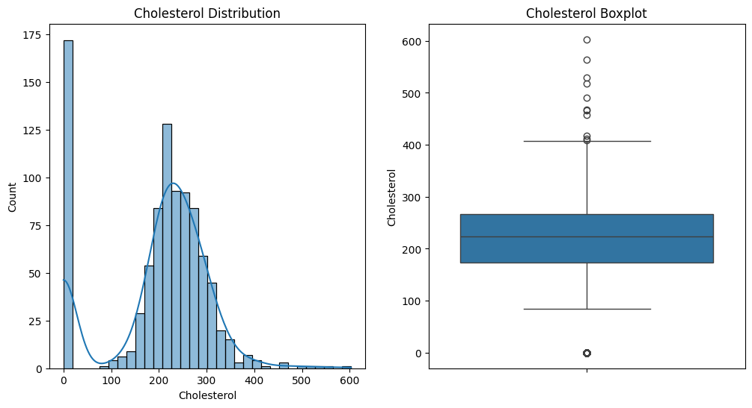
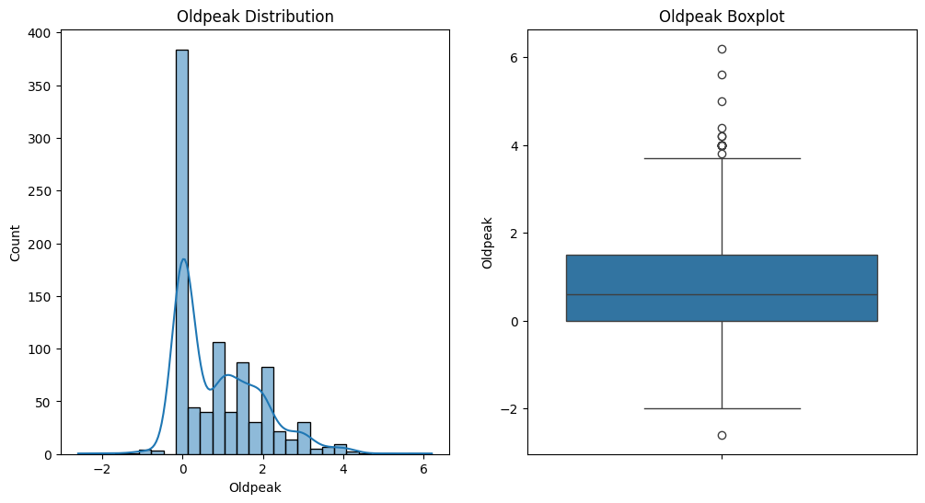
Screenshot

Slide 13
Future Work
Model Optimization :-
Explore advanced hyperparameter tuning techniques to further refine the model.
Dimensionality Reduction :-
This is a specific technique used to simplify the model by reducing the number of features while retaining essential information. It can be a part of model improvement if it helps in making the model more efficient and effective.
Deploy Model with Streamlit :-
Develop a user-friendly web application using Streamlit to visualize predictions, interact with the model, and make it accessible for clinicians and researchers.

Slide 14
Conclusion
In this project, we developed a heart failure prediction model using a Random Forest Classifier, which achieved the best accuracy after outlier removal. The model effectively predicts patient survival (0) and death (1), highlighting the importance of preprocessing in improving predictive performance. This model could assist healthcare providers in identifying high-risk patients and making informed decisions. However, further validation with larger, diverse datasets is necessary to ensure its robustness and generalizability in different clinical settings.

Slide 15

22CSE072 ABHISEK - 9078089401 22CSE094 GOBINDA - 9556185722 22CSE140 DEBABRATA - 9348179664

